Slide 1
GraphML
Hands-on Next-level Machine Learning
Jörg Schad, Ph.D, CTO
Anthony Mahanna, Software Engineer
ODSC West 2023
https://bit.ly/ODSC_GRAPHML

Slide 2
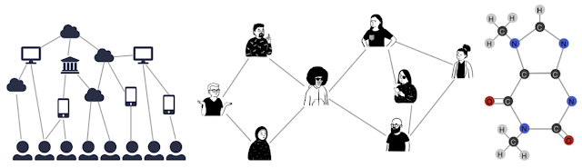
TL;DR
Graphs are everywhere!
“You can make better predictions utilizing relationships within the data than you can from just the data alone.”

Slide 3
Agenda
1.
4.
Graph & ArangoDB 101
Graph + ML
2.
5.
Challenges in Graph
ArangoGraphML
3.
Challenges in ML
Page 3

Slide 4
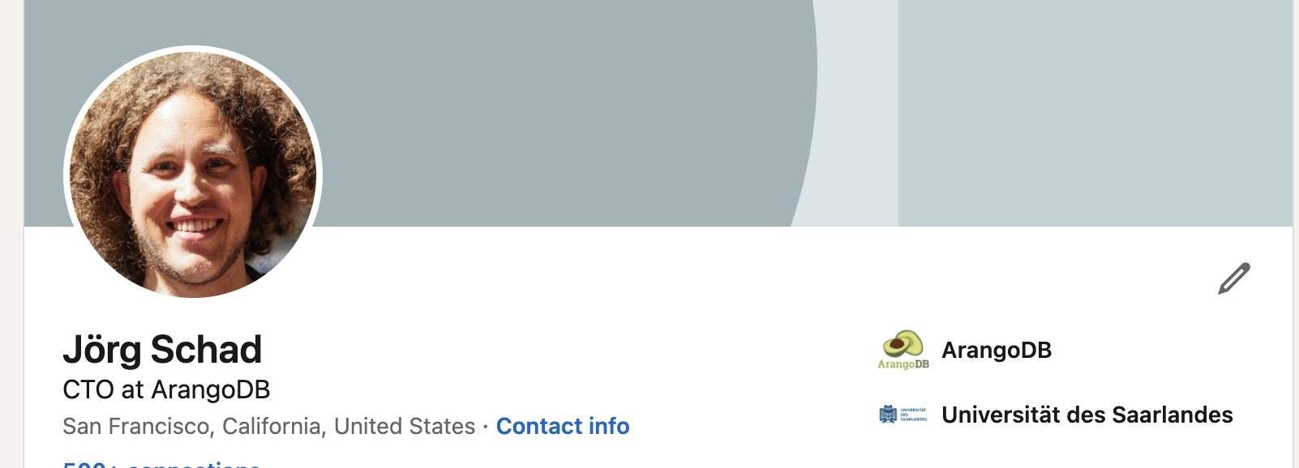
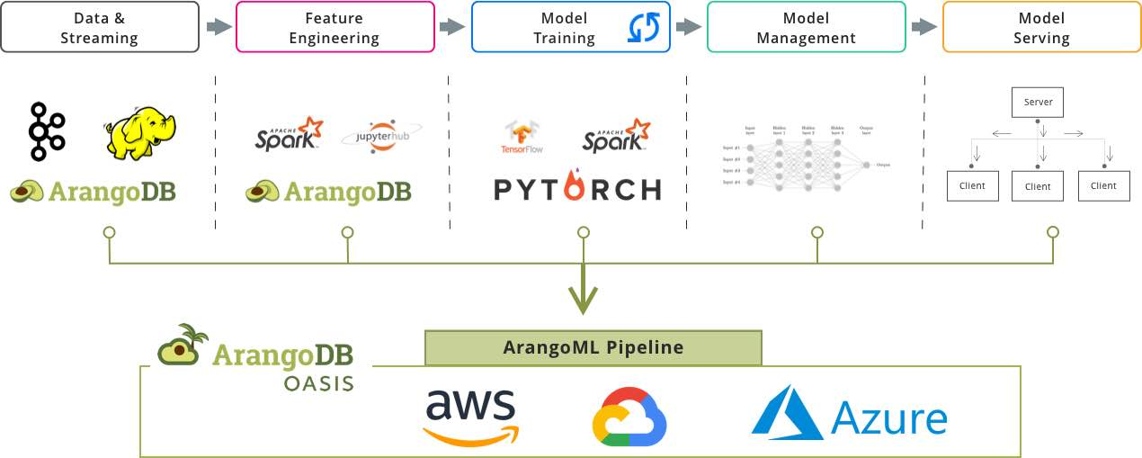


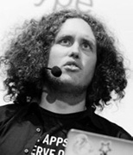
Jörg Schad, PhD
Previously:
Suki.ai
Mesosphere
Architect @SAP Hana
PhD Distributed DB Systems
Twitter: @joerg_schad

Slide 5
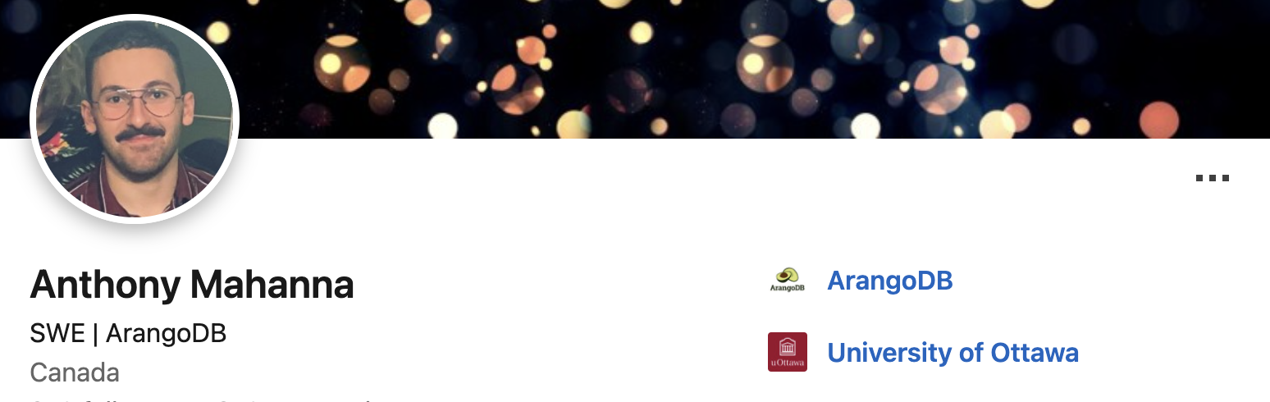
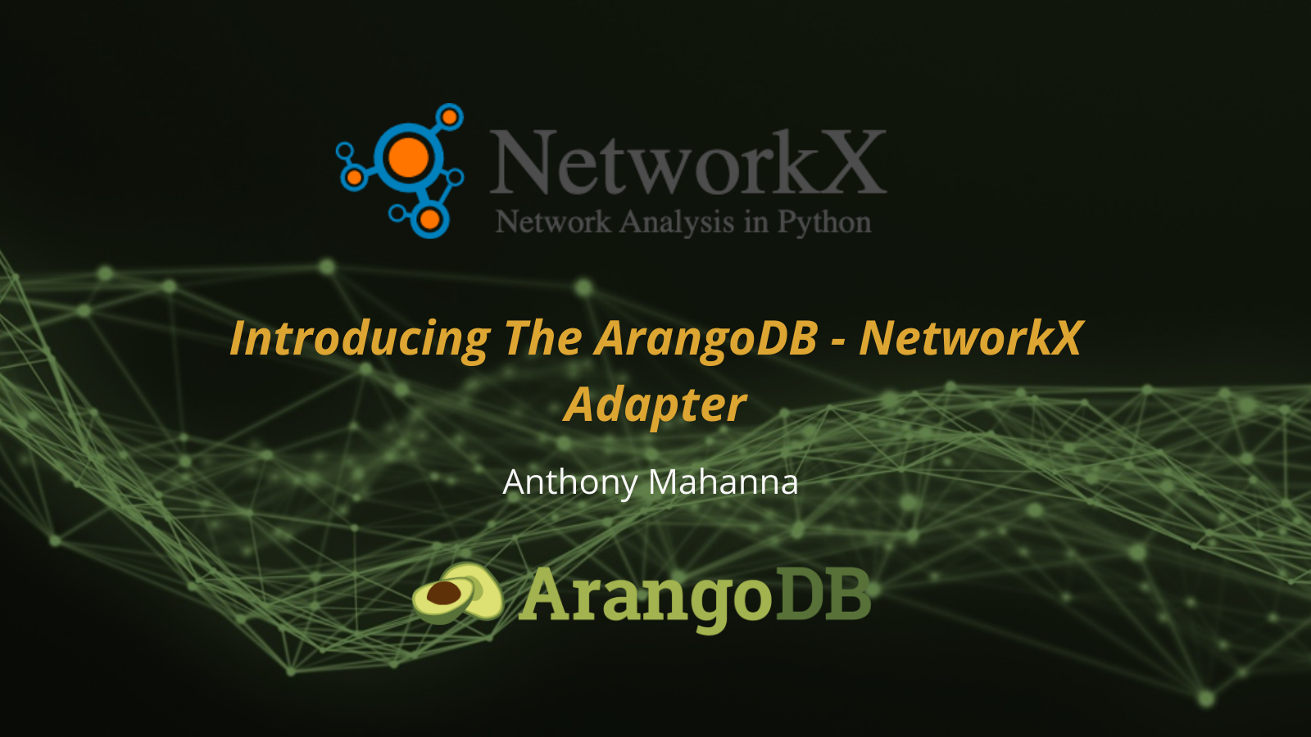
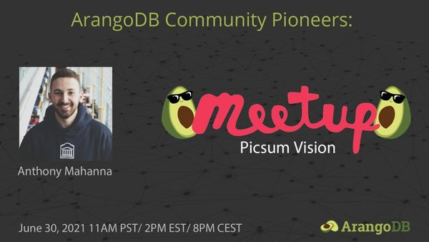
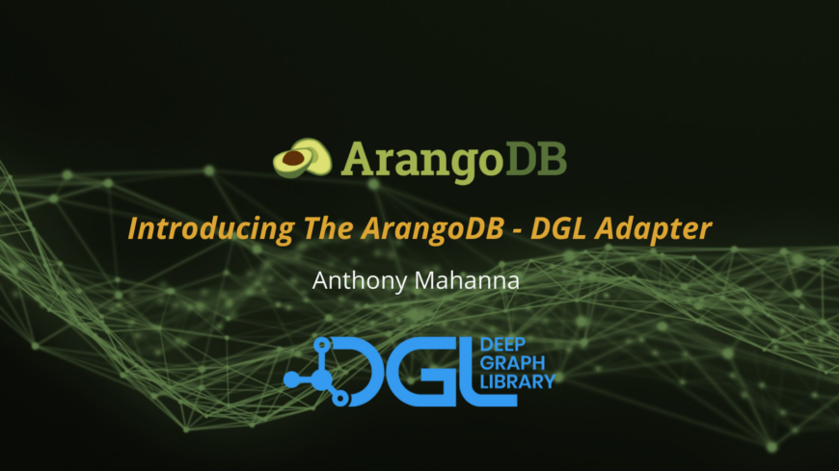
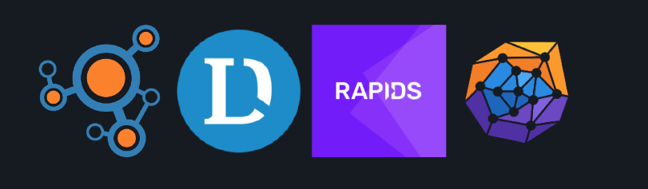
BSc graduate in CS
Development In:
Community (Python)
ArangoML (Python)
Core (C++)
GitHub: aMahanna
anthony.mahanna@arangodb.com

Slide 6

Labs & Notebooks
ArangoDB 101
ArangoDB, scaled.
Graph Embeddings
PyTorch Geometric
Deep Graph Library
Node Classification via PyG
Node Classification via ArangoGraphML
https://bit.ly/ODSC_GRAPHML

Slide 7
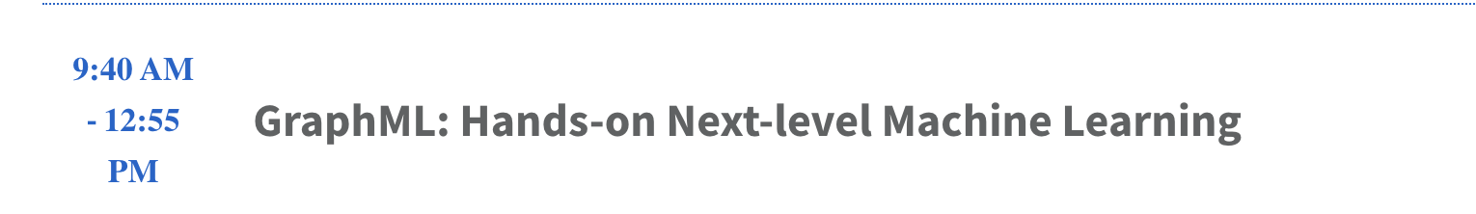
Challenge

Slide 8


This workshop…
Background
Expectations
… is for you!
Please share
Expectations
Questions
Feedback
Ask for breaks if needed!
….
has
has
You
Timezone
lives_in

Slide 9
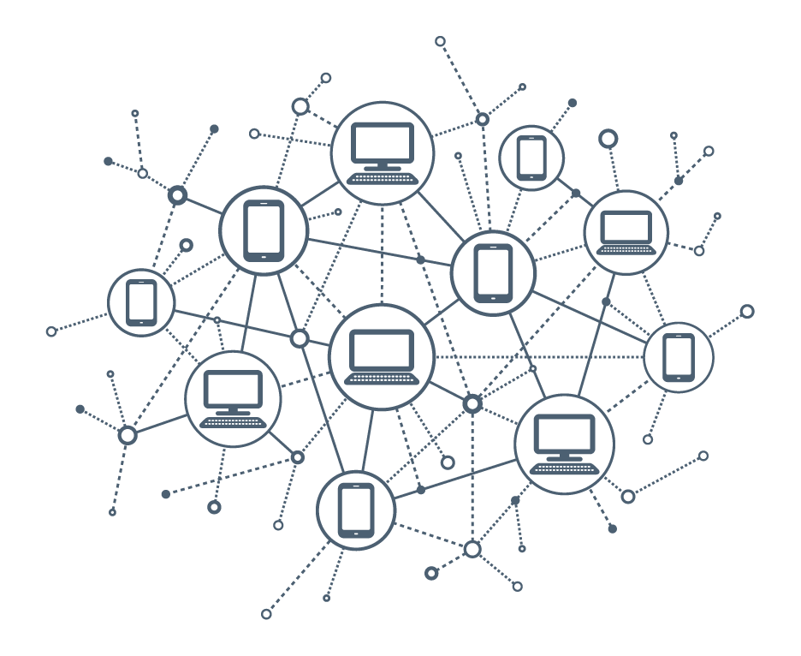
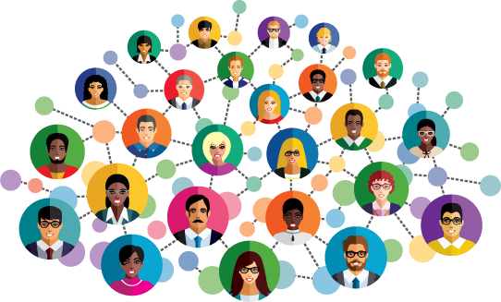
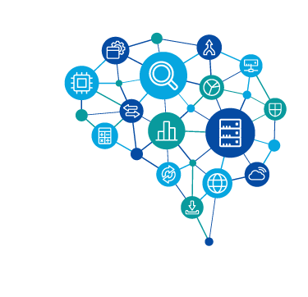
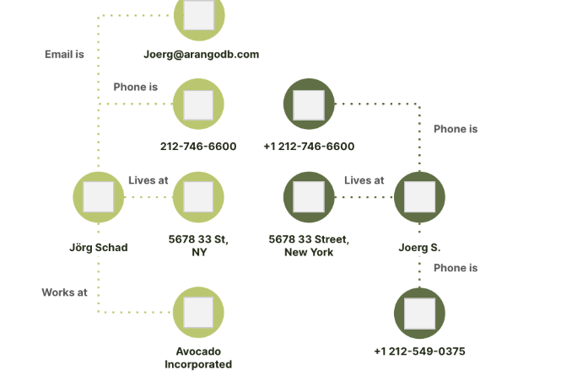
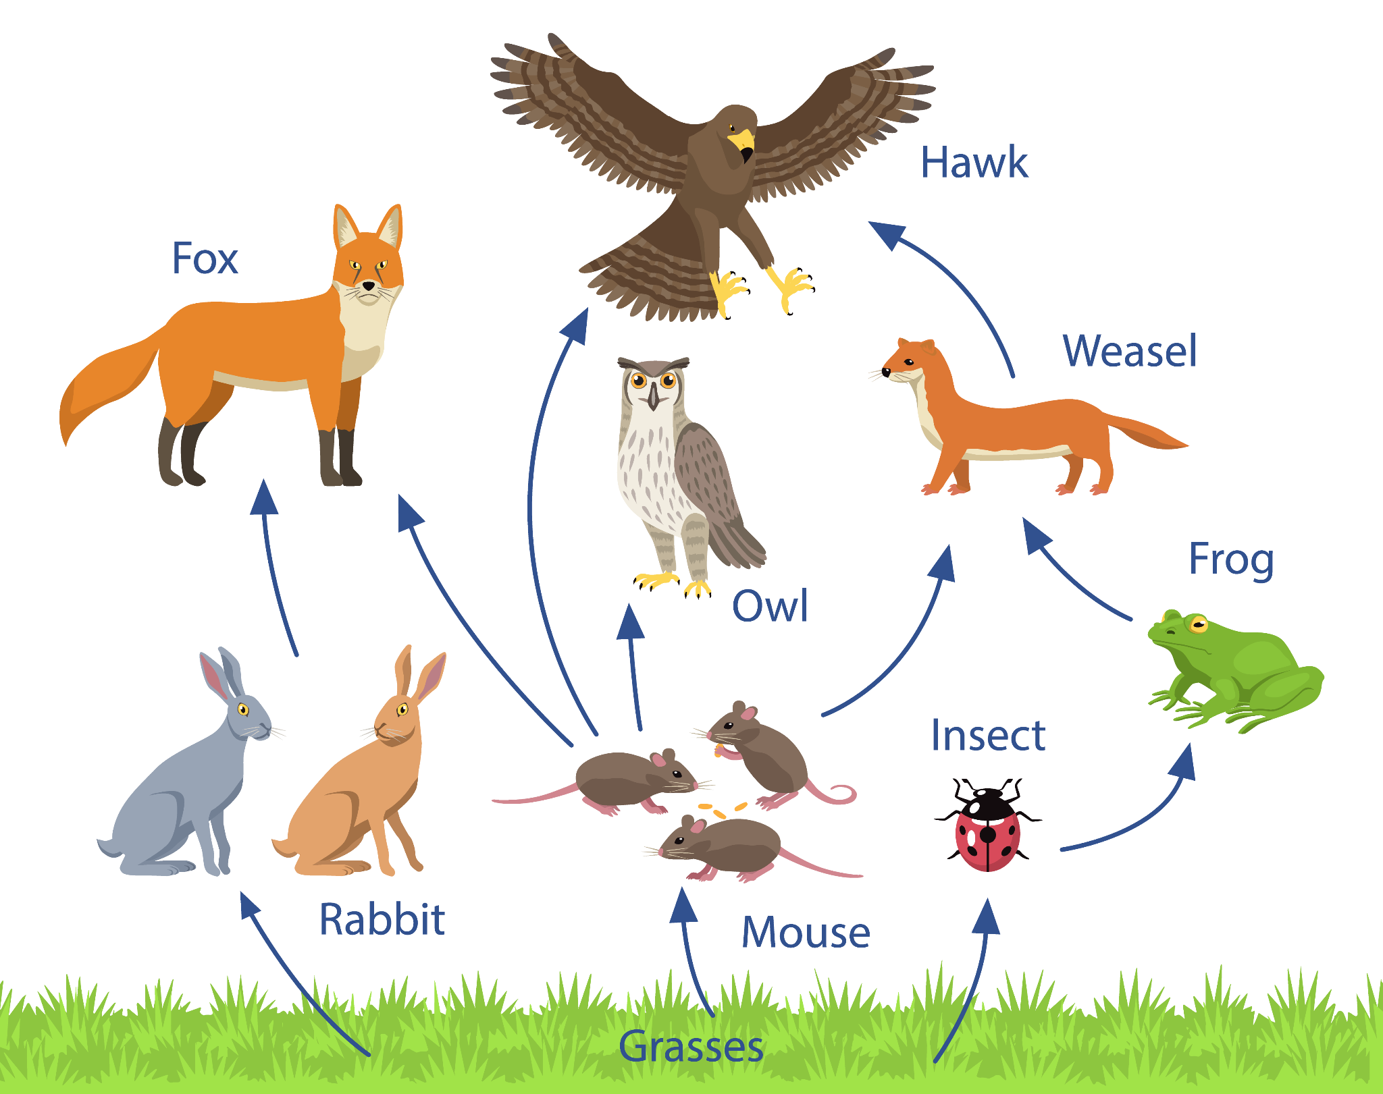
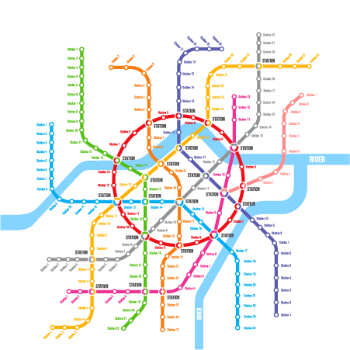
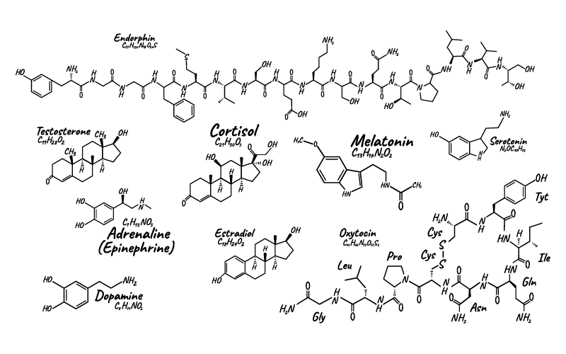
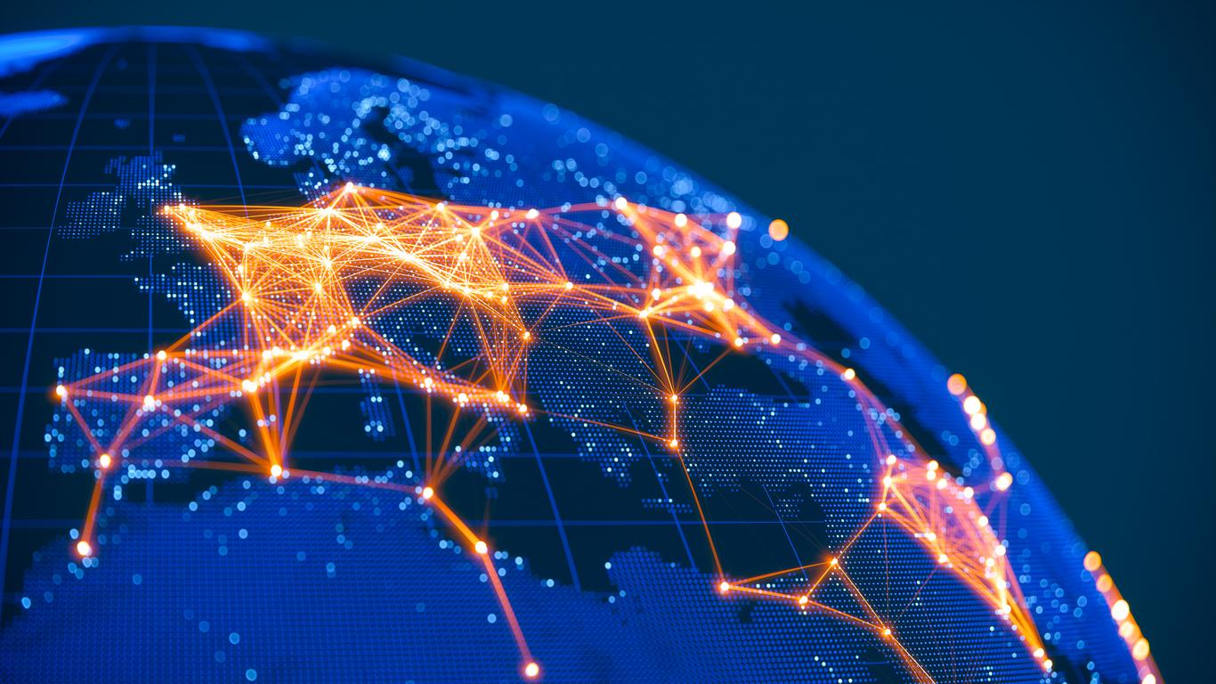
We live in a connected world
Network Assets
Fraud/Security
Social Interactions
Knowledge Graphs
Food Chain
Transportation
Molecules
Communication

Slide 10

We live in a connected world
Graph
Network Assets
Fraud/Security
Social Interactions
Knowledge Graphs
Food Chain
Transportation
Molecules
Communication

Slide 11
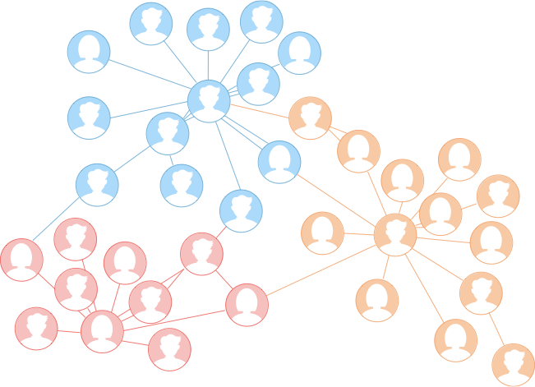
Challenges of Machine Learning
Traditional ML
Independent and identically distributed data
Real connected world…
Homophily - Neighbours are similar
Structural Equivalent nodes
Heterophily - Neighbours are different

Slide 12
Graph
Degree = 4
In Degree = 3
Out Degree = 1
Degree = 5
In Degree = 2
Out Degree = 3
0
Edge
3
5
Transaction
partOf
Knows
Communicates,..
2
Cycle
1
Articulation
Vertex/Node
4
Person,
Server,
Application,
Vehicle, ...
Group/Community
Terrorist Cell, Fraud Ring, …
Graph
Social Network, Terrorist Network, Computer Network, Knowledge Graph

Slide 13
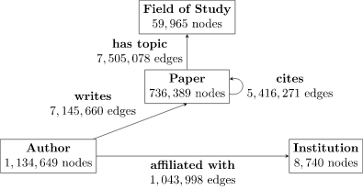
Graph
Graph Properties
(un)directed
Facebook vs Twitter
weighted
Sparse/Dense
(a)cyclic
Homogeneous vs Heterogeneous
Graph Queries
Traversals
Search
...

Slide 14
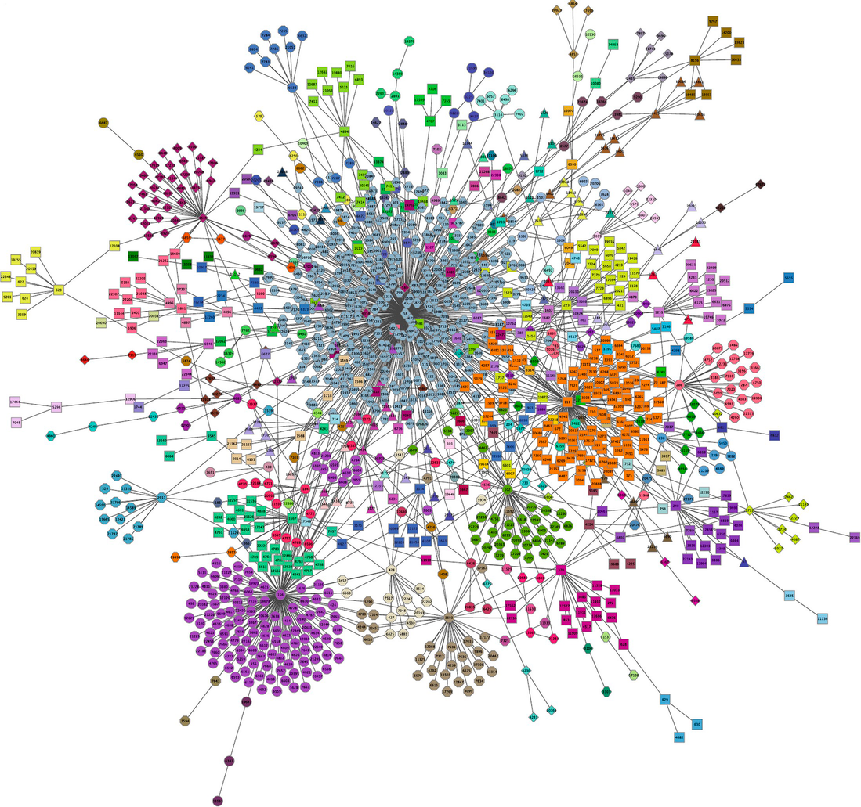
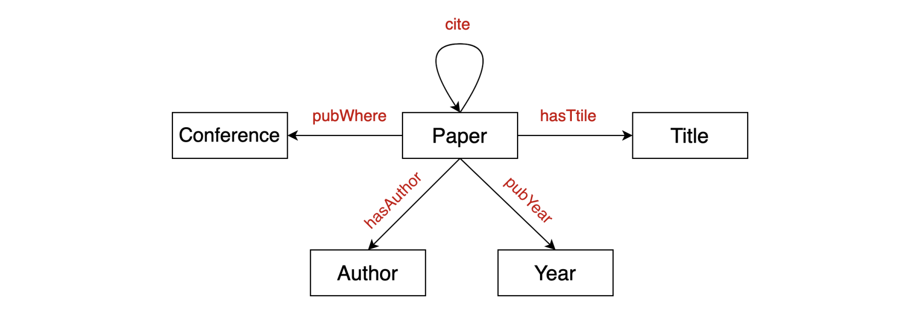
Knowledge Graphs
Representing real-world objects and relationships
Harmonizes data from multiple sources to a canonical model
Shared Vocabulary/Definitions
Can perform logical inference
Examples
Google Knowledge Graph
Amazon Product Graph
Facebook Graph API
Dbpedia

Slide 15
Power of Graph
Making Relationships a First Class Citizen
Context matters
Data relationships are the foundation of AI/ML models
Relational
Graph
Rather than focus on individual rows/entities
Graph captures the context and relationships between entities
Product 1
Product 1
Price
Category
Description
Product 2
Product 2
Price
Category
Description
Product 3
Price
Category
Description
Product 4
Price
Category
Description
Product 3
e.g. Product Listing
Product 4
e.g. Co-Purchase Pattern

Slide 16
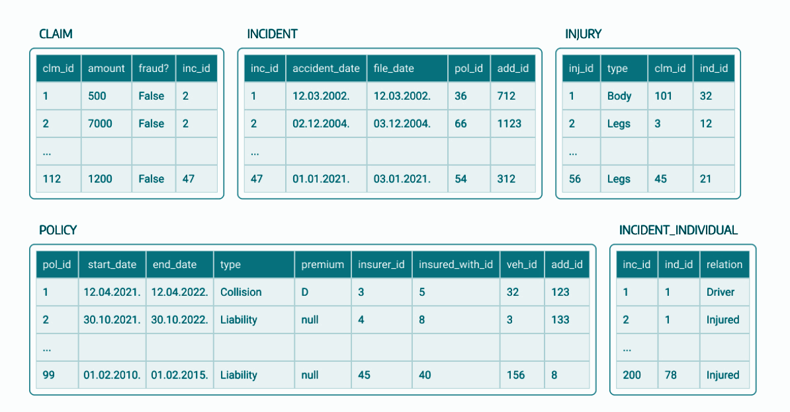
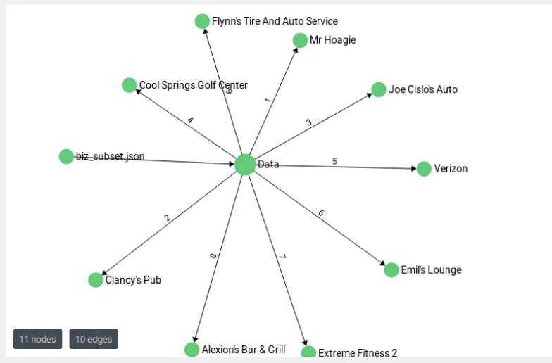
Power of Graph
Analyzing Data in Context
Accelerated Data Retrieval
Accelerated data retrieval avoiding complex joins evaluations
Developer Simplicity
Intuitive Graph Traversal
Flexible Data Modeling
Agile schema evolution
Visualization
Unveiling Complex Patterns

Slide 17
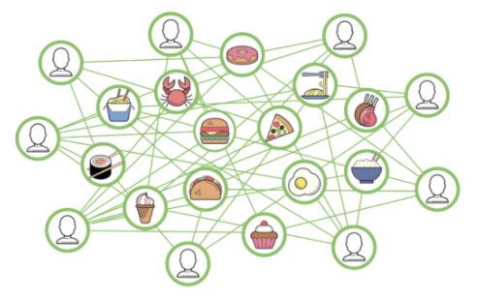
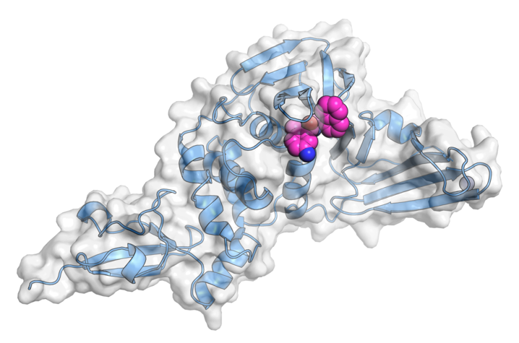
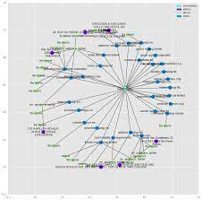
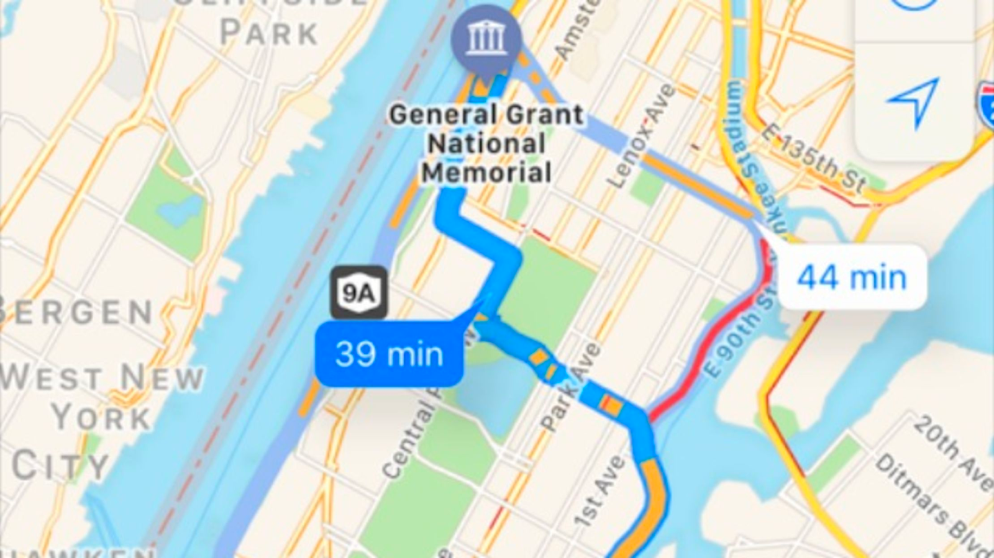
Use Cases
Logistics
ETA Prediction
Delivery Services
Supply Chain
Recommendation/Search
Recommendation
Next Best Action
Semantic Search
Computational Chemistry
Drug Discovery
Drug Adverse Effects
Drug Repurposing
Financial Services
Credit Scoring
Fraud Detection
Insider Trading
eg. Google DeepMind ETA Prediction
eg. UberEats Recommendation
eg. Epitopes.World COVID-19 Therapies Research
eg. Panama Papers Discovery

Slide 18
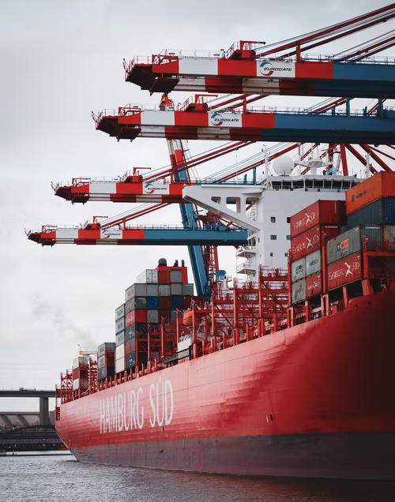

Case Study: Altana - Supply Chain
Scenario: Global supply chain analytics
Altana AI helps their customer build efficient, resilient & compliant supply chains.
Model a global supply for customers in manufacturing, logistics, shipping, and government.
Requirements
Scalability: Connect billions of data points to create a single source of supply chain truth.
Completeness: Build knowledge graph of products, the manufacturers that build them; the containers they’re packed into; the ships, trains, and trucks that ship them, etc.
Why ArangoDB
High scalability: Analytics on a knowledge graph that’s 20 TB in size.
Operational efficiency: Cloud database-as-a-service reduced time spent by Ops team.
Usability: Developers loved AQL, ArangoDB’s query language.
Results & Metrics
Increased revenue: Drove revenue by letting customers better forecast supply, reduce fraud and risk, speed shipments through customs, and ensure compliant sourcing.
Reduced cost: Easily integrated with existing Elastic and AWS infrastructure, reducing engineering costs.

Slide 19
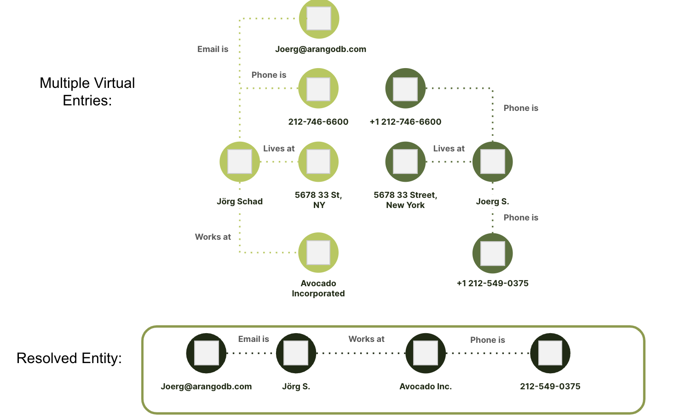
Entity Resolution
Entity resolution is the ability to resolve and identify relationships using linkages between disparate data often coming from different data sources.
Use Cases
Cyber Fraud
Financial Services
Supply Chain
Customer Identification/Marketing
…

Slide 20
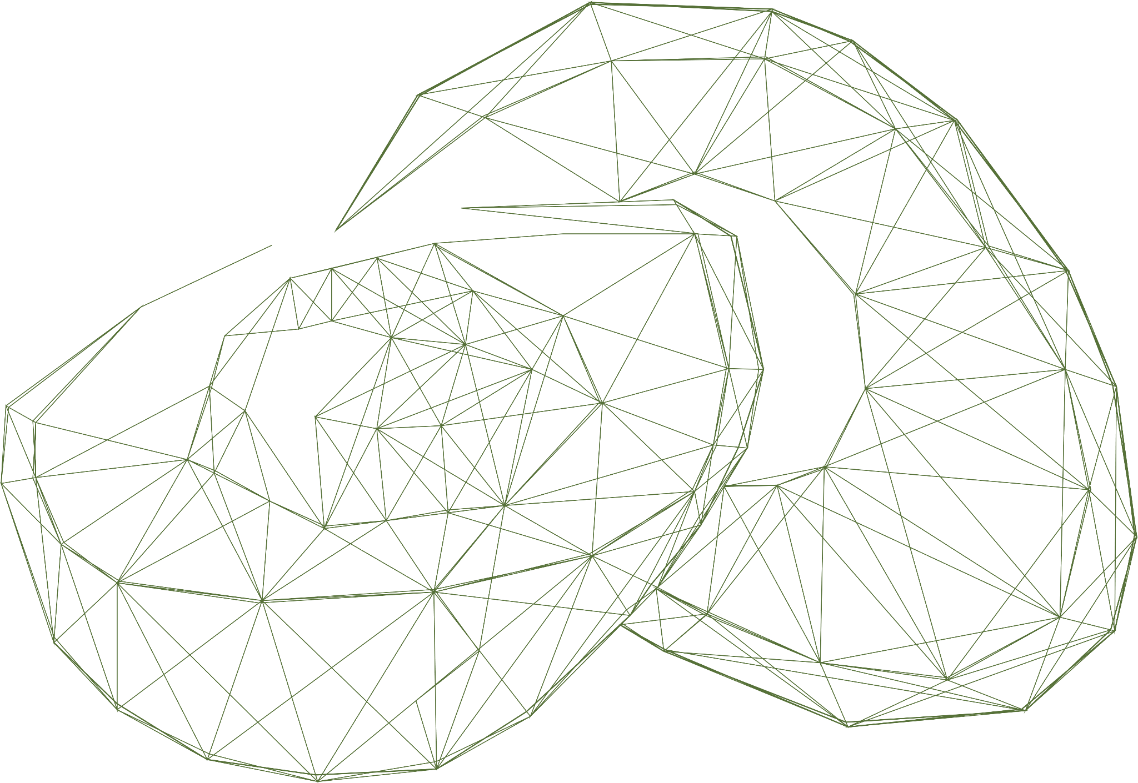

ArangoDB
Unmatched Scalability Transparent and horizontal scalability
Graph-as-a-Service Modern fully-managed service allowing users to truly focus on their data and not the management!
Going Beyond Graph Combines Graph with Full-Text Search and Document Drill Down
Graph Analytics Graph Algorithm Library
Data Ecosystem Integration and Drivers connecting everywhere
#1 OSS Community Supported by large, active open source community
GRAPH Database
Graph
Machine Learning Cutting edge ML algorithms and Graph Neural Network support

Slide 21
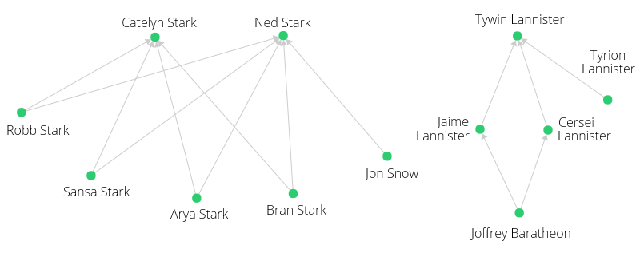
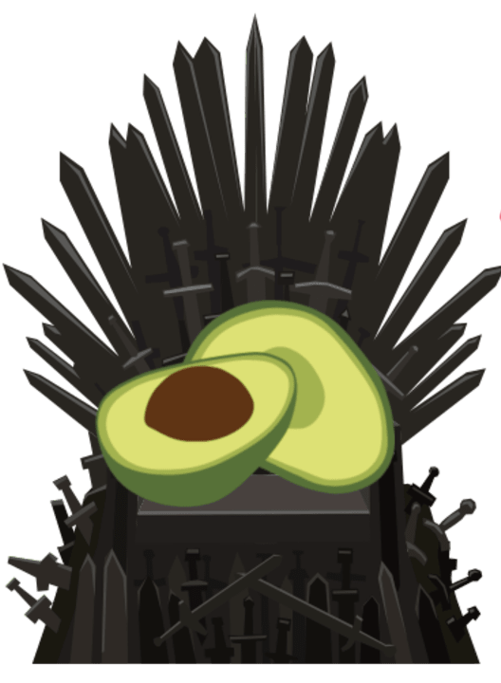


Lab: ArangoDB 101

Slide 22
Performance at Scale
Unique Features for cutting-edge performance at any scale
Enterprise Graph - Complex graphs at any scale with an extraordinary performance.
SatelliteCollections - Star data model at any scale
SatelliteGraphs - Replicate graphs to each server for optimal teamplay of graphs and other data models.
SmartJoins - Efficient joins for sharded collections using co-location of data.
OneShard Database - Unique feature to allow for transactional guarantees, high availability and cutting-edge performance at the same time.
Pregel - Iterative Graph Analytics at Scale

Slide 23
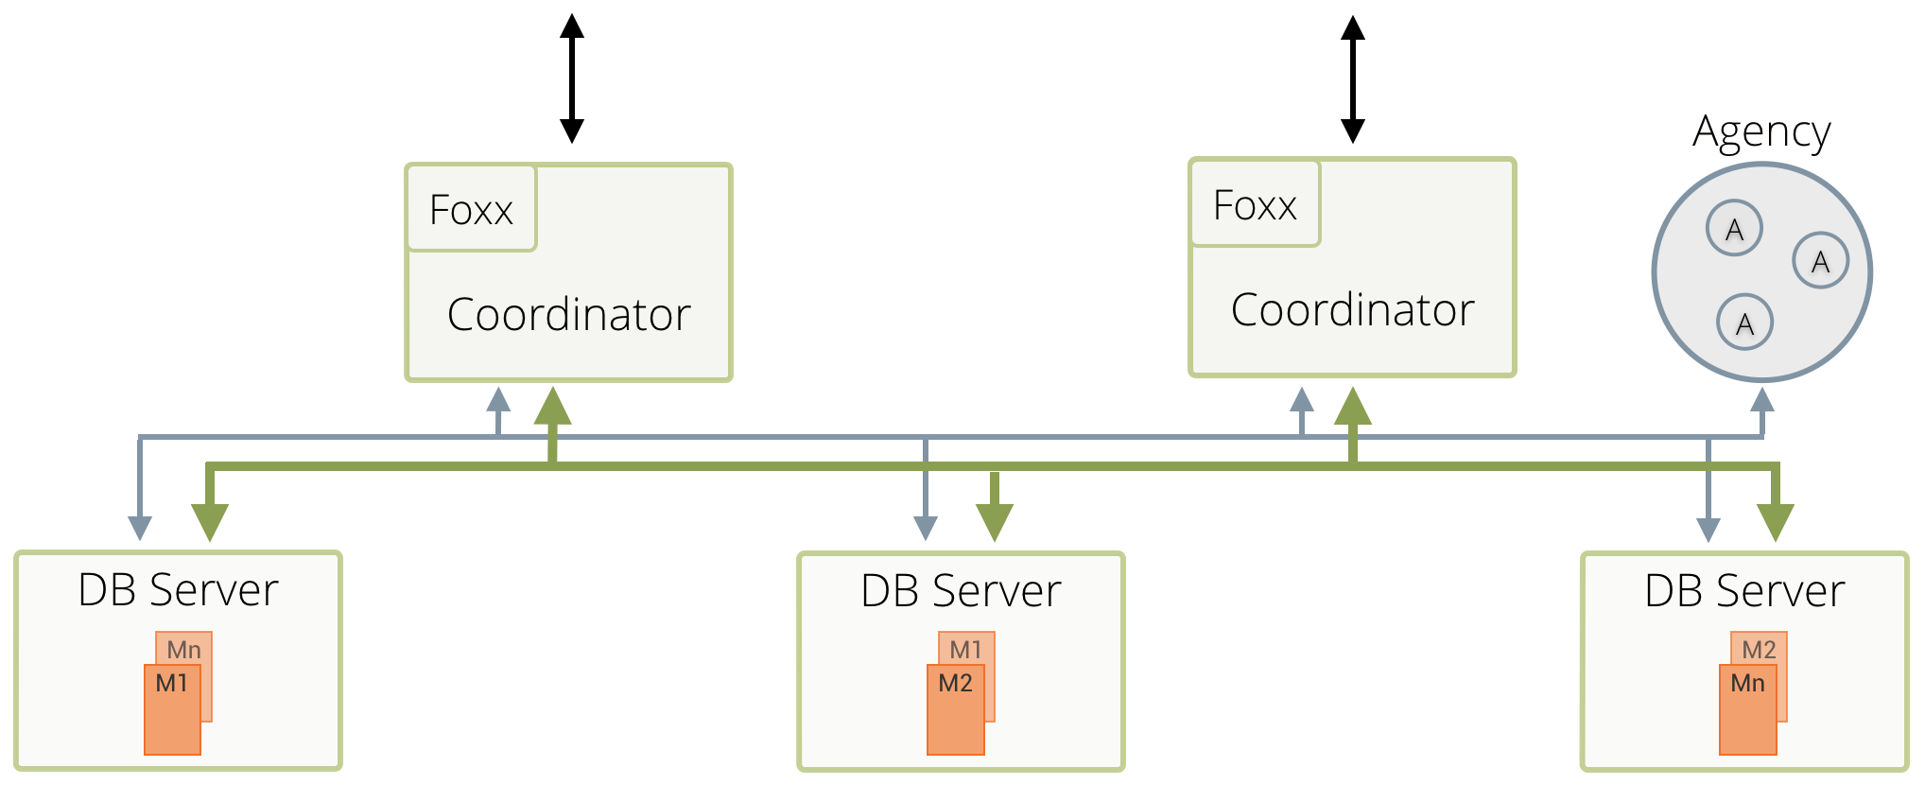
Cluster
For the various instances in an ArangoDB Cluster there are three distinct roles:
Agents
Coordinators
DB-Servers.

Slide 24
Scalability
DB Server 1
DB Server 2
DB Server 3

Slide 25
Transparent Scalability
Coordinators
Coordinators
DB Server 1
DB Server 2
DB Server n

Slide 26
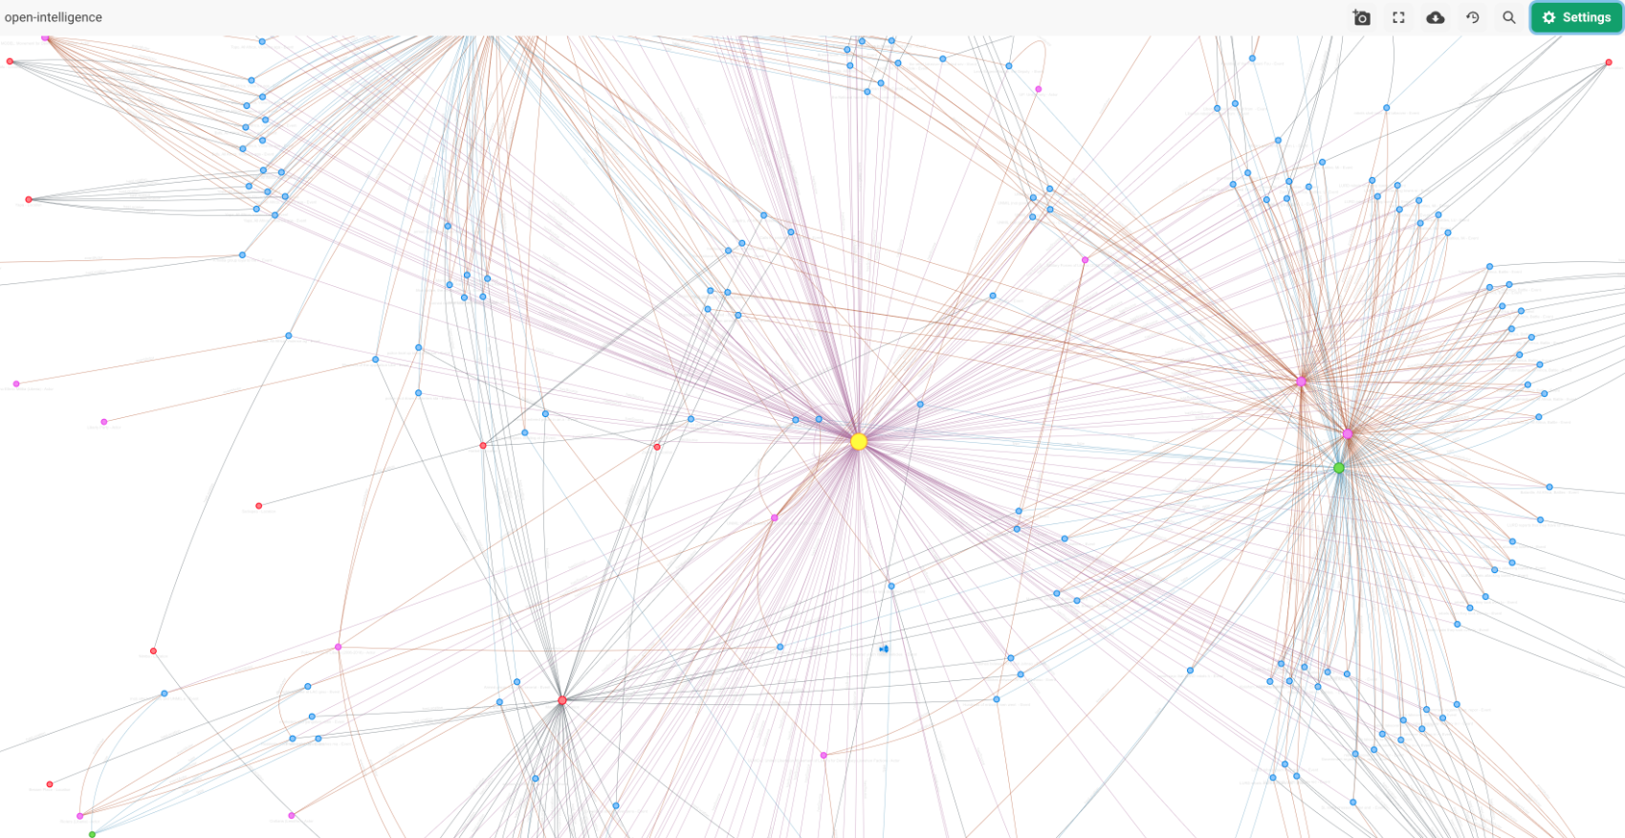
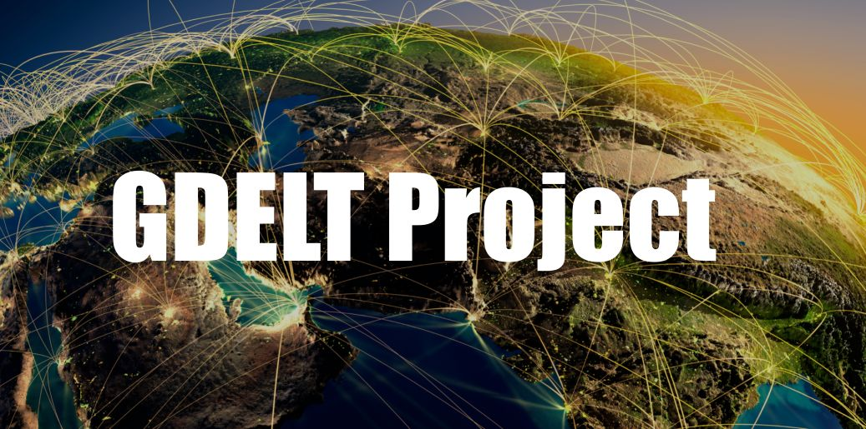
Lab: ArangoDB, scaled.

Slide 27
Machine Learning

Slide 28
Challenges of Machine Learning
Traditional ML
Independent and identically distributed data
Real connected world…
Homophily - Neighbours are similar
Structural Equivalent nodes
Heterophily - Neighbours are different

Slide 29
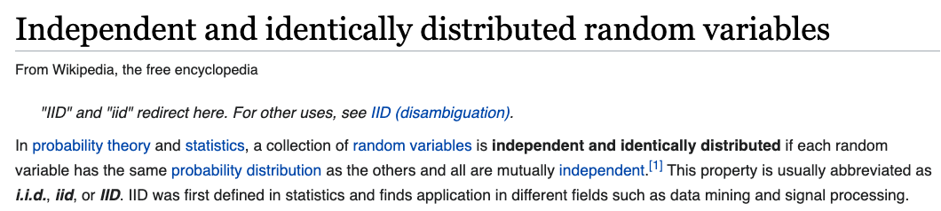
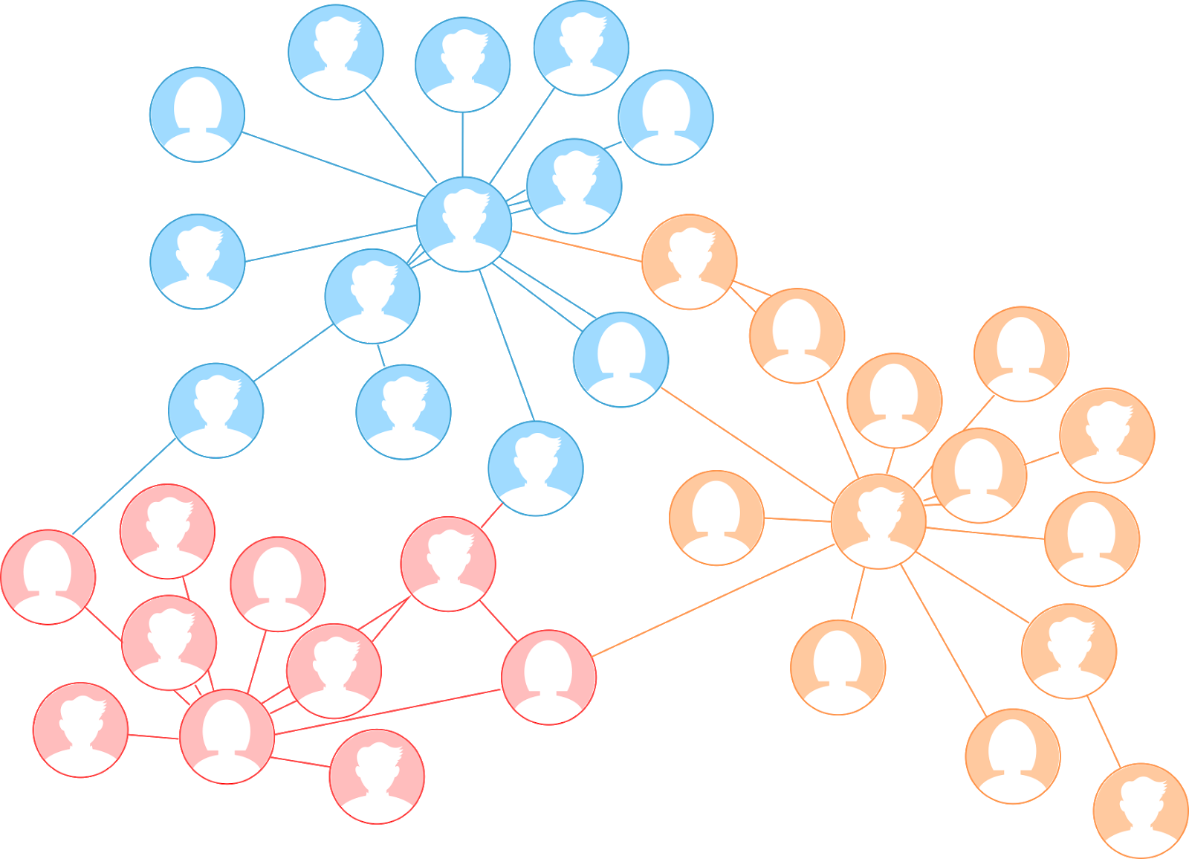
Challenges of Machine Learning

Slide 30
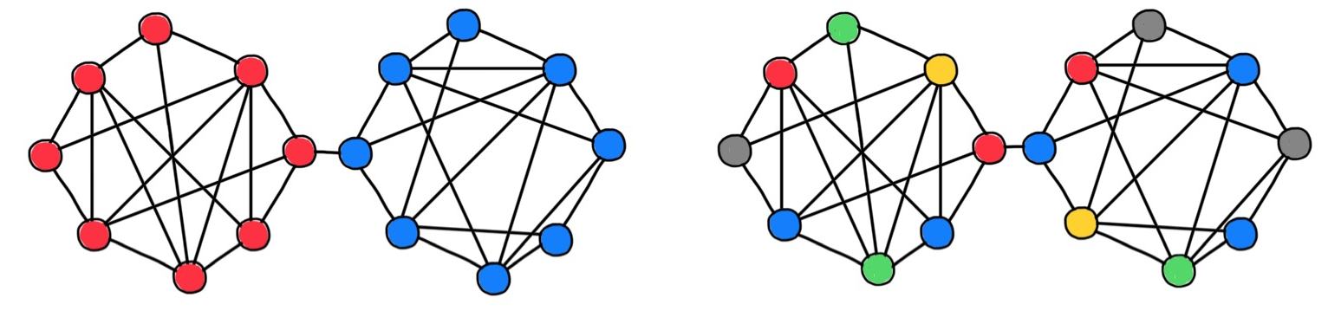
Homophily vs Heterophily
https://thegradient.pub/graph-neural-networks-beyond-message-passing-and-weisfeiler-lehman/

Slide 31
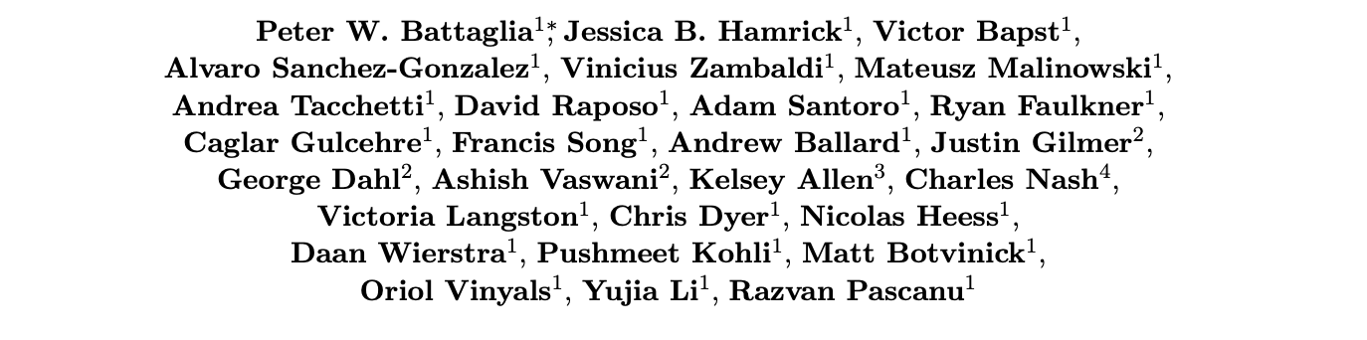
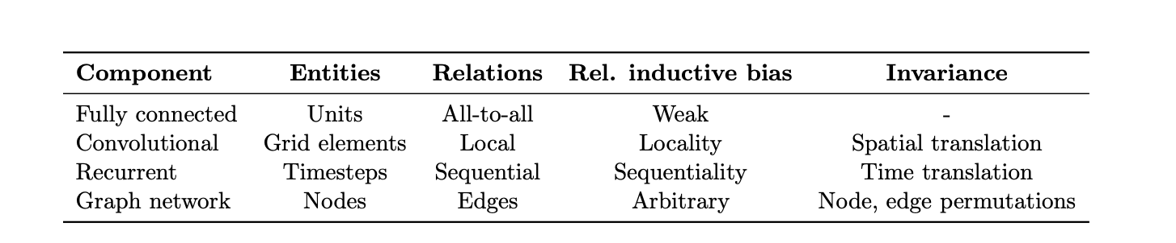
Relational inductive biases, deep learning, and graph networks
https://arxiv.org/abs/1806.01261

Slide 32
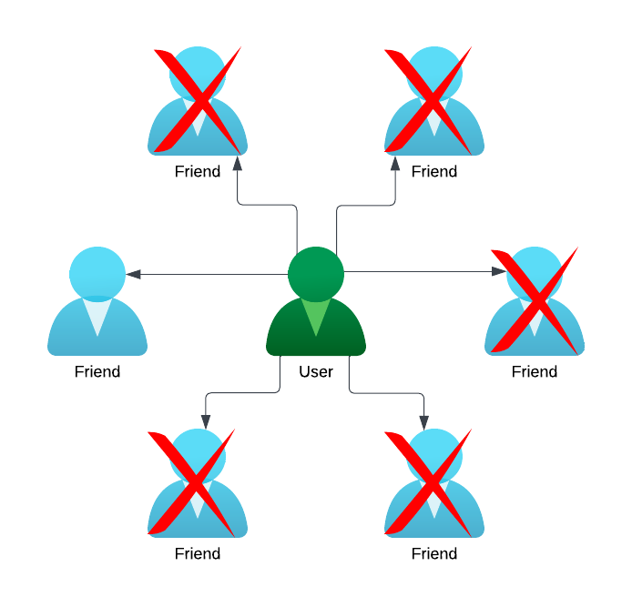
GraphML More Accurate Insights
Take an example of a social network, with a model predicting potential churn:
What traditional ML sees
What GraphML sees
Username | John_Doe1990
Age | 33
Country | USA
Gender | Male
Total Posts | 730
Total Friends | 25
Year Joined | 2016
Device | iOS
ID Verified | True
This user won’t churn based on others I’ve seen of similar age, with a similar number of posts, that use iOS
This user will probably churn because most of their friends have churned
In datasets with relationships, Stanford research shows Graph Machine Learning can be 50% more accurate than traditional ML methods

Slide 33
GraphML Capabilities
Find similar nodes, edges, graphs
Group nodes, edges, graphs
Similarity Search
Cluster
Predict properties & edges
Detect unusual nodes, edges, graphs
Impute Data
Anomaly
Unsupervised
Supervised
Classify nodes, edges, graphs
Downstream Conventional ML
Classification
ML Pipeline

Slide 34
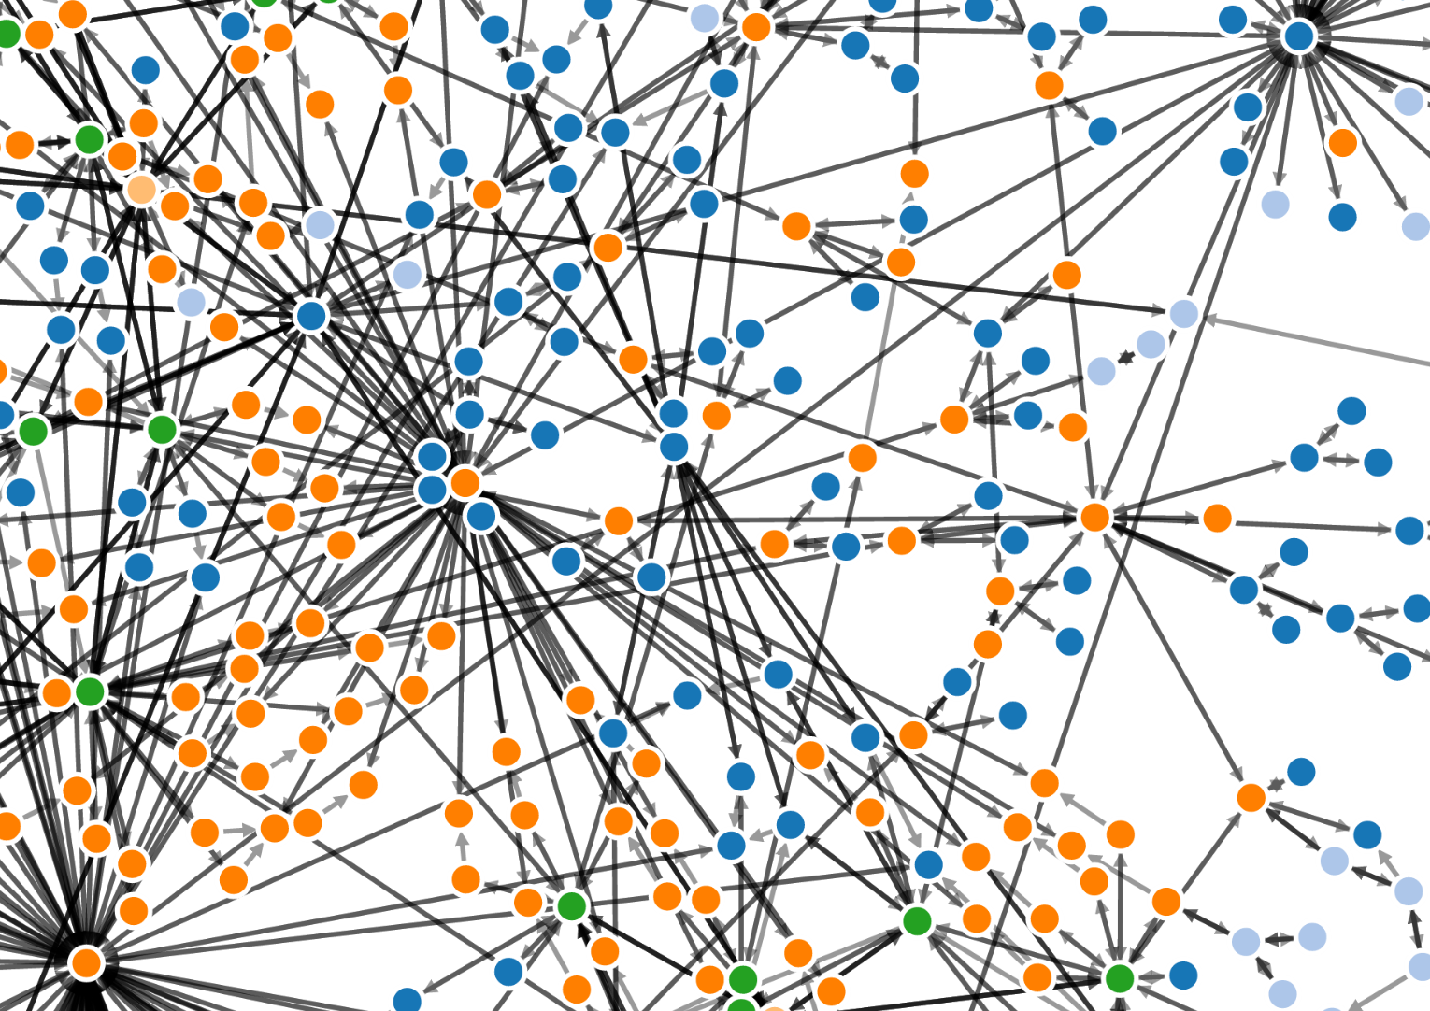
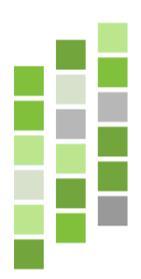
Graph ML & Embeddings
Host 1
Neighborhood
Encode
Find Similar
Identify unusual
Group
Predict
Classify
GNN
Solve
Embeddings
Similar
Decode
Host 2
Knowledge Graph
Graph Embedding
Visualization

Slide 35
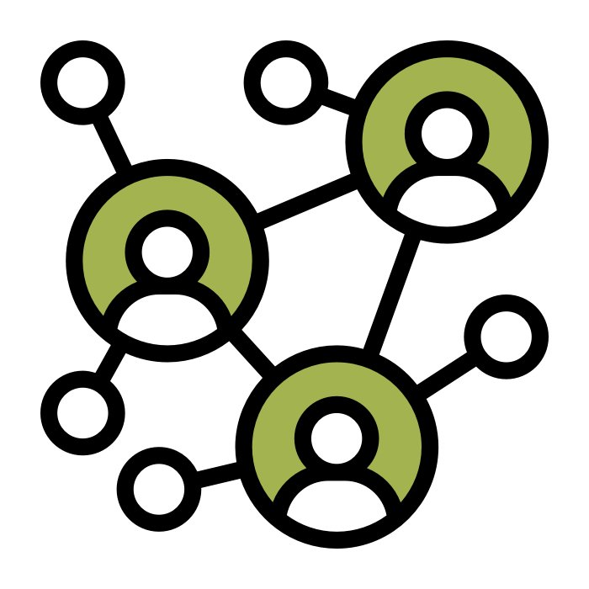
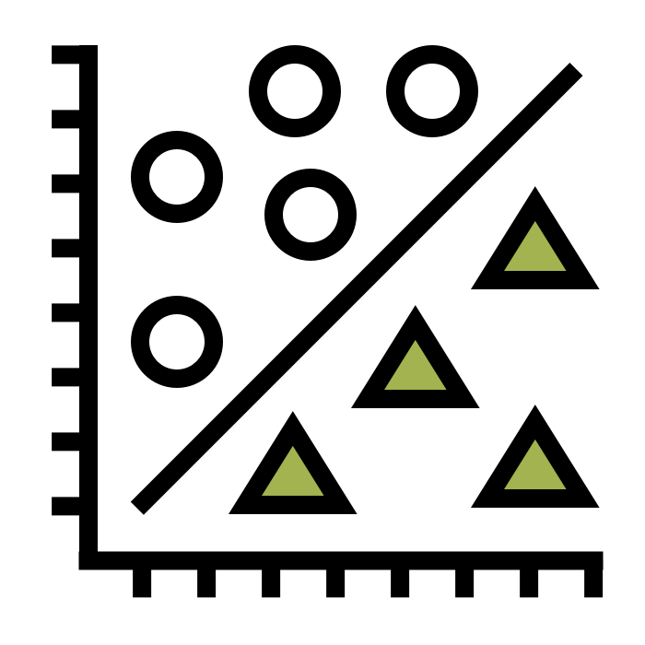
Embeddings
Graph
Embedding

Slide 36
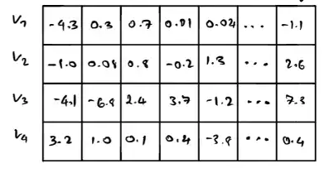
Embeddings
Graph
Embedding

Slide 37

Preserving properties…
Word embedding is the collective name for a set of language modeling and feature learning techniques in natural language processing (NLP) where words or phrases from the vocabulary are mapped to vectors of real numbers.
Wikipedia
https://towardsdatascience.com/creating-word-embeddings-coding-the-word2vec-algorithm-in-python-using-deep-learning-b337d0ba17a8

Slide 38
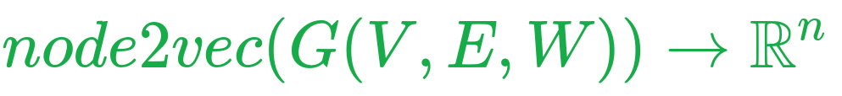
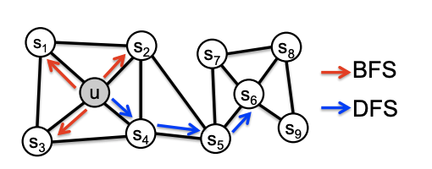
Graph Embeddings
ML (mostly)works on vectors
Vertex Embeddings
Edge Embeddings
Graph Embeddings
Knowledge Graph Embeddings
Similar nodes/graphs should have similar embeddings (vectors)
Homophily equivalence
Structural equivalence
similar rules
https://towardsdatascience.com/graph-embeddings-the-summary-cc6075aba007

Slide 39
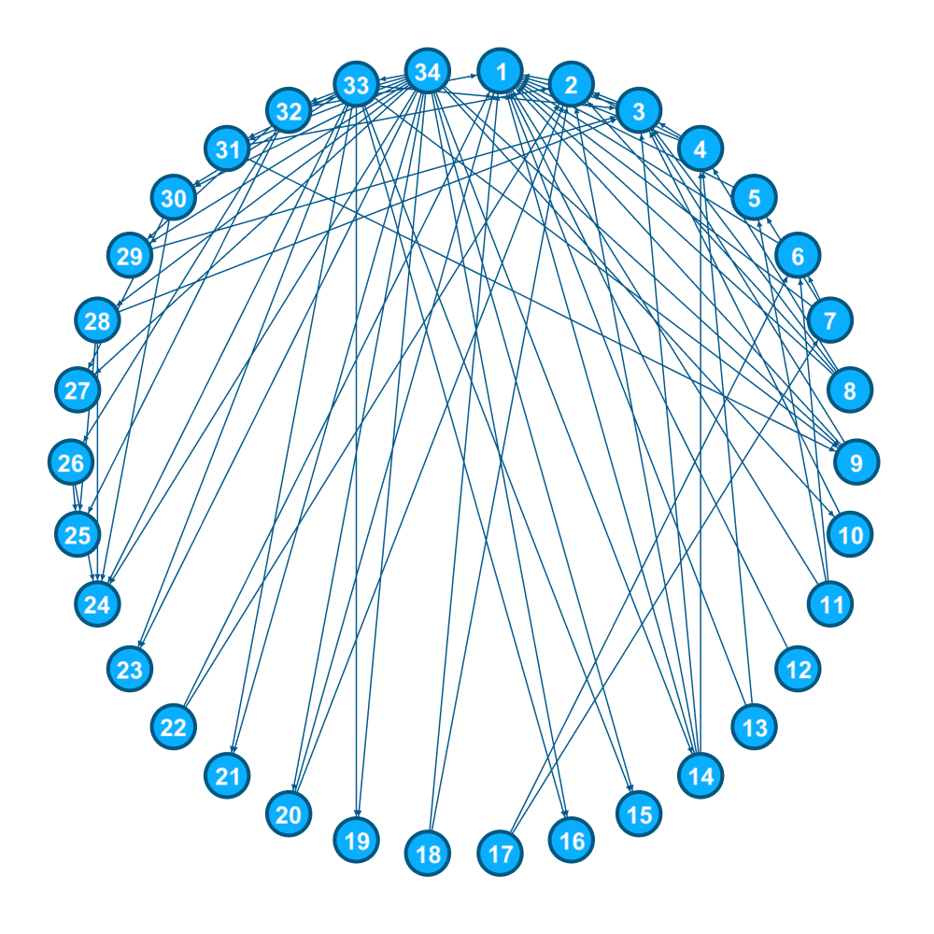

Lab: Graph Embeddings

Slide 40

Word2Vec
What are close words?
Words appear in the same context.
Skip-Gram Network
Dummy task: Predict context
https://towardsdatascience.com/introduction-to-word-embedding-and-word2vec-652d0c2060fa
http://mccormickml.com/2016/04/19/word2vec-tutorial-the-skip-gram-model/

Slide 41

Skip Gram Network
https://towardsdatascience.com/node2vec-explained-db86a319e9ab

Slide 42

Embedding
https://towardsdatascience.com/introduction-to-word-embedding-and-word2vec-652d0c2060fa
http://mccormickml.com/2016/04/19/word2vec-tutorial-the-skip-gram-model/

Slide 43

Word2Vec
https://towardsdatascience.com/introduction-to-word-embedding-and-word2vec-652d0c2060fa
http://mccormickml.com/2016/04/19/word2vec-tutorial-the-skip-gram-model/

Slide 44


From words to nodes
Words can be sampled from text...
Nodes can be sampled from random walks
-> Probability of going back
-> Probability of staying in subgraph
-> Probability of exploring
https://arxiv.org/pdf/1607.00653.pdf

Slide 45

Node2Vec
https://arxiv.org/pdf/1607.00653.pdf
https://towardsdatascience.com/graph-embeddings-the-summary-cc6075aba007

Slide 46


Graph Neural Networks
https://www.youtube.com/watch?v=uF53xsT7mjc

Slide 47

Graph Neural Networks
*Node/Graph/Edge Embeddings
https://www.youtube.com/watch?v=uF53xsT7mjc

Slide 48


Uber Eats
https://eng.uber.com/uber-eats-graph-learning/

Slide 49

Supervised vs Unsupervised Training
GNNs can be trained either supervised or unsupervised
Supervised: Explicit target function
Unsupervised: predict neighborhood “positive” (node, node) & “negative/random” (node, node) pairs

